Slide 1
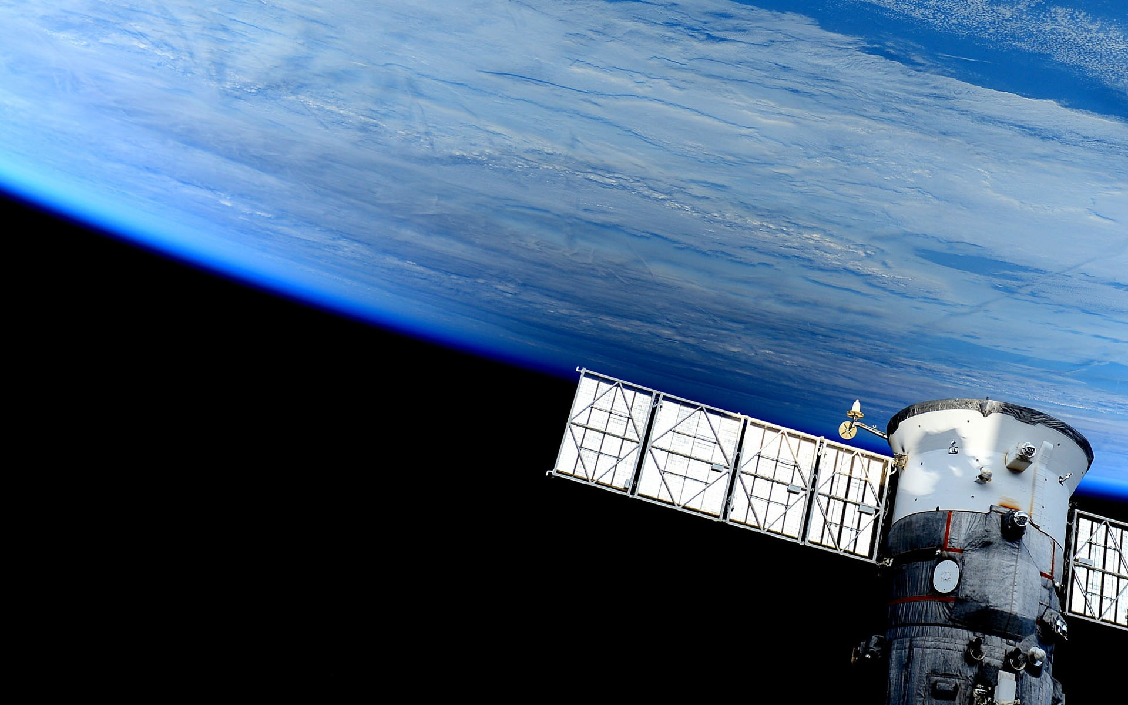

Batteries Tester
Blanca Cano Camarero
Javier Germán Luzón Hidalgo
Miguel Romero García

Slide 2
First functional interface
We have finished web page server.
Let have a direct prove:
  Select test.
  Save data.
  Update recollected data.
Command to invoque:

